Slide 1


STOCK MARKET ANALYSIS
REAL-TIME DATA OF MICROSOFT, TESLA, APPLE…

Slide 2

TABLE OF CONTENTS
OVERVIEW
BUSINESS PROBLEM
DESCRIPTIVE ANALYSIS
TREND EXPLORATION & VISUALASTIONS
CONCLUSIONS
RECOMMENDATIONS

Slide 3
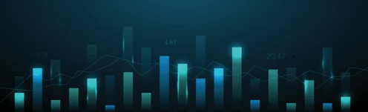
OVERVIEW
The overview of this analysis aims to compare the stock performance of Microsoft, Apple, and Tesla from 2018 to 2023 using live data sourced from Yahoo Finance, which includes daily stock prices and S&P 500 index values.
The focus is on calculating and analyzing the percentage changes in stock prices for each company, allowing for a comparison of their performance against the S&P 500 index.
By identifying trends and patterns in these stocks, the analysis seeks to enhance understanding of how each company's stock responds to market fluctuations and to provide insights that can inform investment strategies.

Slide 4
BUSINESS PROBLEM
This analysis examines the livestock data of Microsoft, Apple, and Tesla, sourced from Yahoo Finance, covering daily values from 2018 to 2023 alongside S&P 500 data. The dataset includes the percentage change in stock values, labelled as %change. Using the Capital Asset Pricing Model, we will calculate the Beta coefficient through regression analysis of each stock's excess returns against the S&P 500 returns. This Beta value indicates relative risk; higher Betas suggest greater risk and the potential for higher returns.

Slide 5

DESCRIPTIVE ANALYSIS
The Descriptive Analysis provides key statistics from the dataset of daily stock prices for Microsoft, Apple, and Tesla from 2018 to 2023, including mean, median, standard deviation, and price ranges (minimum and maximum).
This analysis highlights trends in stock performance and compares the behavior of these companies against each other and the S&P 500 index, offering valuable insights into their stability and volatility.
This dataset serves the purpose of analyzing and comparing the stock performance of these prominent U.S. companies, identifying trends, volatility, and correlations with the broader market as represented by the S&P 500 index.

Slide 6
KEY METRICS IN OPENING STOCK PRICES ANALYSIS
KEY ANALYSIS OPEN | MSFT | TESLA | APPLE | SP&500
Mean | 194.47 | 131.90 | 98.57 | 3457.03
Standard Error | 2.08 | 3.28 | 1.29 | 18.65
Median | 203.58 | 96.57 | 95.09 | 3294.67
Mode | 95.14 | 24.00 | 127.82 | 2832.41
Standard Deviation | 74.23 | 117.17 | 46.18 | 666.56
Sample Variance | 5510.45 | 13728.01 | 2132.24 | 444300.94
Kurtosis | -1.29 | -1.26 | -1.58 | -1.30
Skewness | 0.15 | 0.47 | 0.12 | 0.33
Range | 258.56 | 399.40 | 146.64 | 2513.80
Minimum | 86.06 | 12.07 | 35.99 | 2290.71
Maximum | 344.62 | 411.47 | 182.63 | 4804.51
Sum | 248533.81 | 168562.08 | 125977.71 | 4418089.57
Count | 1278.00 | 1278.00 | 1278.00 | 1278.00
The Opening Stock Prices Analysis examines the opening prices at which Apple, Tesla, and Microsoft traded from 2018 to 2023, with a particular emphasis on important metrics such as the opening price mean, median, and standard deviation.
An understanding of each company's market position and stock responses to economic situations can be gained from this analysis, which emphasizes trading behavior, stability, and volatility.
When mean opening prices from 2018 and 2023 are compared, it can be seen that Tesla is leading with growth potential at $131.90, Microsoft is leading with strong market confidence at $194.47, Apple is showing steady demand at $98.57, and the S&P 500's mean of $3457.03 is the benchmark for overall market performance.
The comparison of standard deviations from 2018 to 2023 shows varying volatility levels: Microsoft has a moderate volatility at $74.23; Tesla exhibits higher volatility at $117.17; Apple has the lowest volatility at $46.18, indicating stability; and the S&P 500 shows the highest volatility at $666.56, reflecting significant overall market fluctuations. This highlights Tesla's greater risk compared to the more stable performance of Apple.

Slide 7
KEY METRICS IN ADJUSTED CLOSE STOCK PRICES ANALYSIS
KEY ANALYSIS ADJ CLOSE | MSFT | TESLA | APPLE | SP&500
Mean | 190.83 | 131.79 | 97.39 | 3457.23
Standard Error | 2.10 | 3.27 | 1.30 | 18.65
Median | 198.82 | 97.64 | 94.15 | 3298.03
Mode | 89.88 | 23.62 | 41.25 | 2783.02
Standard Deviation | 75.19 | 116.98 | 46.57 | 666.78
Sample Variance | 5653.29 | 13684.08 | 2168.54 | 444593.79
Kurtosis | -1.31 | -1.26 | -1.58 | -1.30
Skewness | 0.14 | 0.47 | 0.12 | 0.33
Range | 259.87 | 398.04 | 146.65 | 2559.16
Minimum | 80.06 | 11.93 | 34.31 | 2237.40
Maximum | 339.92 | 409.97 | 180.96 | 4796.56
Sum | 243876.63 | 168427.98 | 124462.16 | 4418340.01
Count | 1278.00 | 1278.00 | 1278.00 | 1278.00
Highlighting important metrics including mean, median, and standard deviation, the Adjusted Close Stock Prices Analysis examines the Tesla, Apple, and Microsoft adjusted closing prices from 2018 to 2023.
This analysis provides insights into each company's response to market swings over time by exposing trends in market performance and volatility.
The mean adjusted close prices from 2018 to 2023 show Microsoft at $190.83, indicating strong investor confidence; Tesla at $131.79, reflecting dynamic growth; and Apple at $97.39, highlighting steady demand. The S&P 500’s mean adjusted close price of $3457.23 serves as a benchmark for overall market performance, facilitating comparisons of these companies against broader market trends.
The comparison of standard deviations of adjusted close prices from 2018 to 2023 reveals important volatility insights: Microsoft has a moderate volatility at $75.19, indicating stability; Tesla shows higher volatility at $116.98, reflecting significant price fluctuations; Apple exhibits lower volatility at $46.57, suggesting a stable investment; while the S&P 500 has the highest volatility at $666.78, highlighting overall market fluctuations driven by economic factors. This emphasizes Tesla's greater risk compared to Microsoft and Apple

Slide 8
KEY OBSERVATION
Tesla: High growth potential, high risk.
Microsoft: Strong confidence, moderate risk.
Apple: Steady demand, low risk.
S&P 500: Market benchmark with high fluctuations
RECOMMENDATIONS FOR STOCK INVESTMENT
For growth-oriented investors: Consider Tesla with caution due to volatility.
For stability-focused investors: Choose Apple for lower risk.
For balanced exposure: Microsoft offers a middle ground.
Monitor the S&P 500 to assess overall market trends.

Slide 9
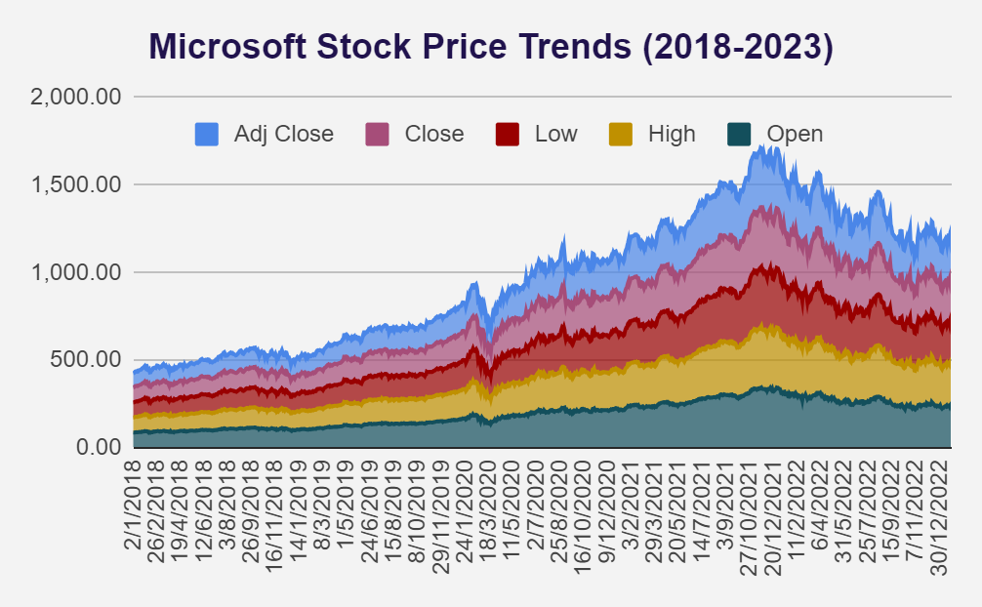
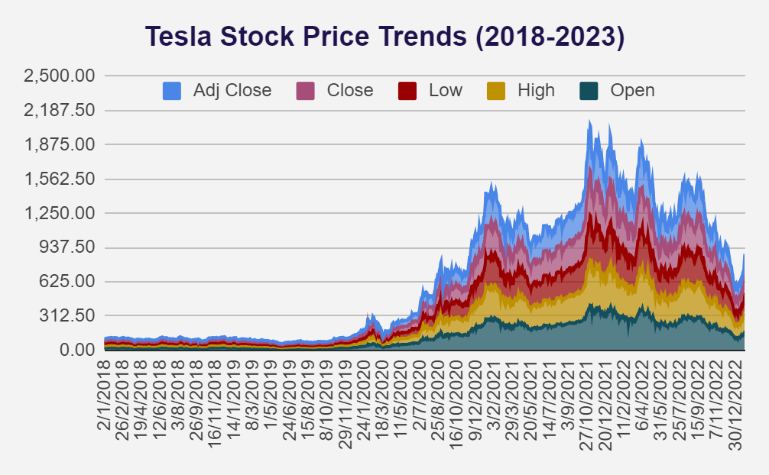
TREND EXPLORATION & VISUALASTIONS
The trend chart for Microsoft and Tesla highlights key price movements. Microsoft shows steady growth and strong investor confidence in opening prices, while Tesla’s fluctuate significantly.
Tesla's high prices reflect its volatility, with pronounced peaks, while Microsoft's highs are more stable. Tesla exhibits greater variability in low prices, indicating market susceptibility, whereas Microsoft remains resilient.
Both companies show upward trends in closing prices, with Microsoft consistently higher, while adjusted close prices mirror these trends, emphasizing Tesla's volatility compared to Microsoft's steady growth.

Slide 10
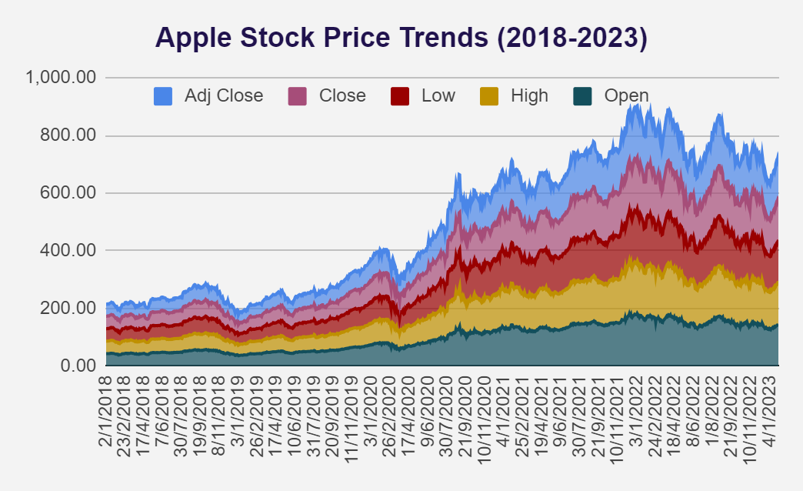
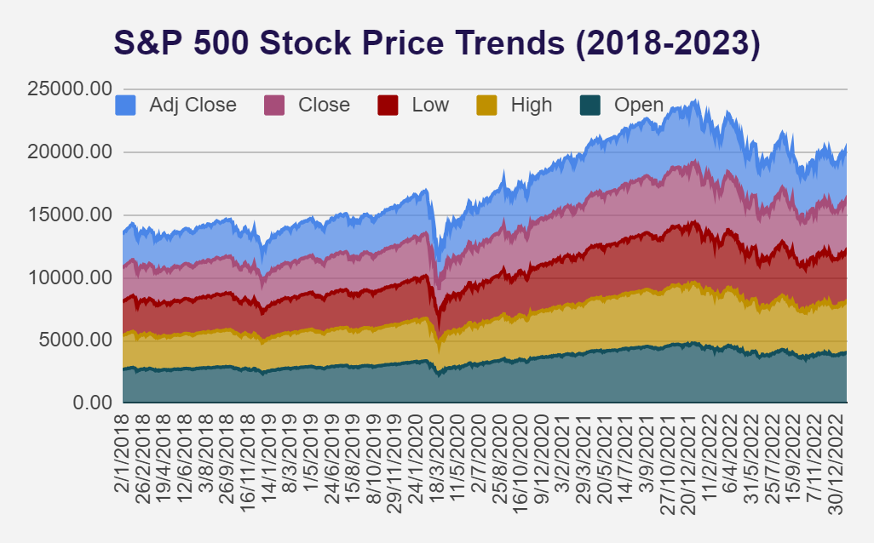
TREND EXPLORATION & VISUALASTIONS
The trend chart for Apple and the S&P 500 shows Apple’s consistent growth and strong investor confidence, with high prices indicating robust interest.
In contrast, the S&P 500 reflects broader market trends with moderated highs.
Both exhibit upward trends in closing prices, with Apple consistently outperforming the index, emphasizing its strong growth relative to the overall market.

Slide 11
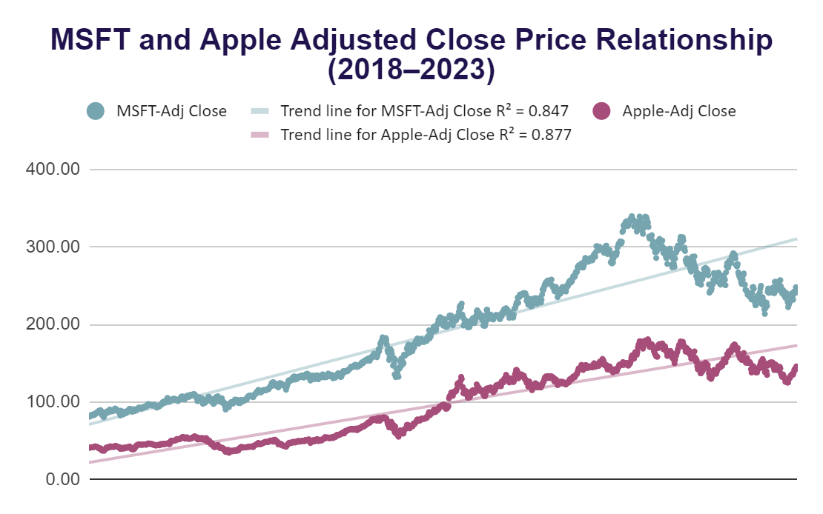
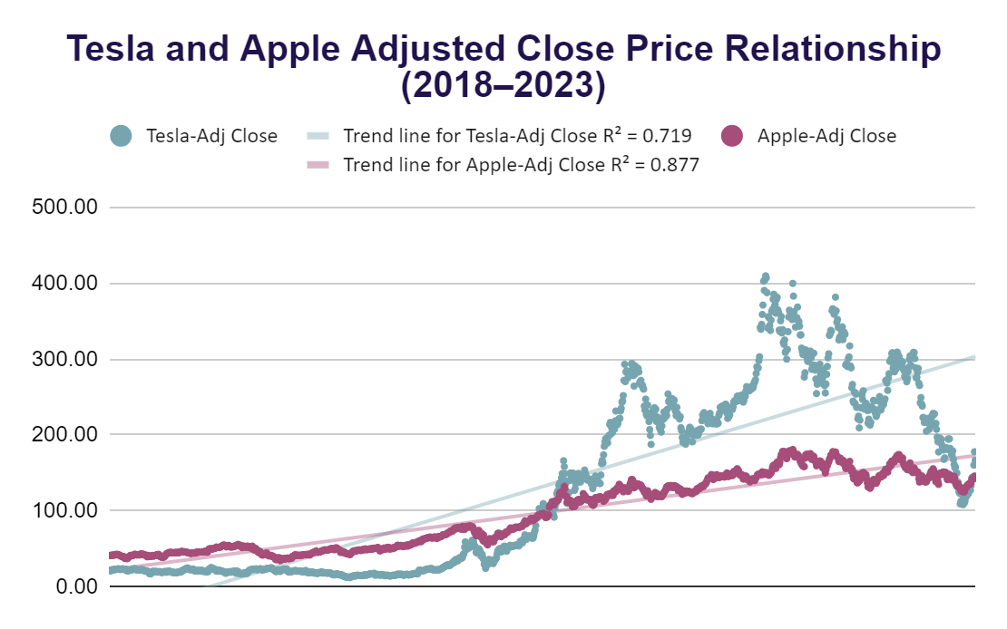
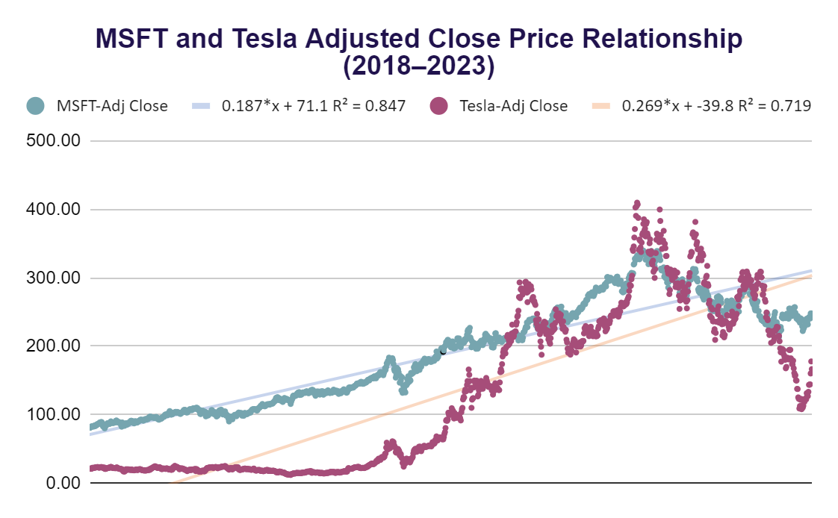
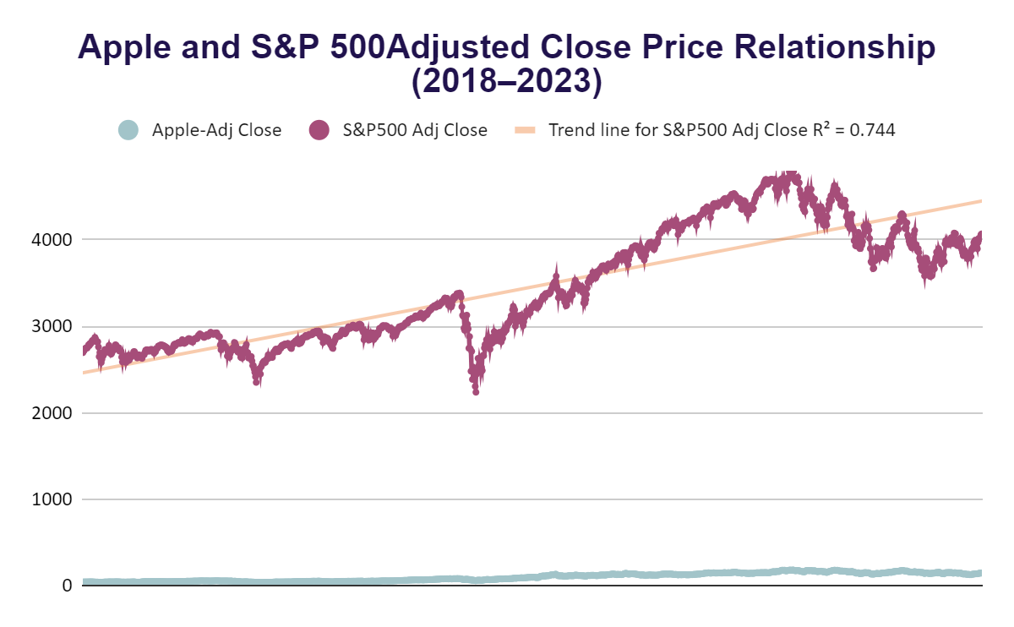
Correlation Analysis of Stock Performance

Slide 12
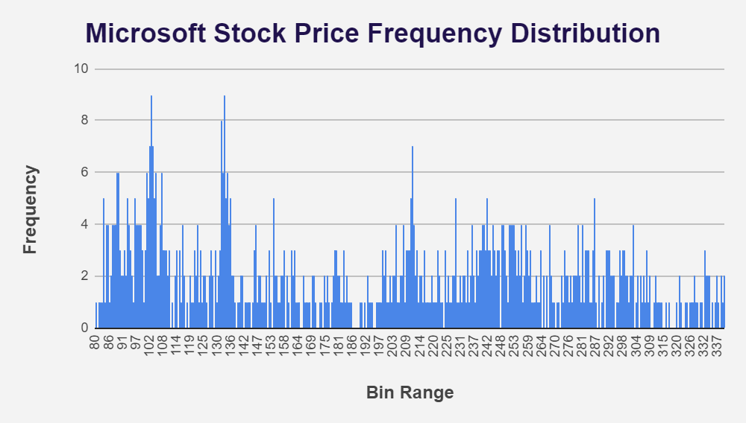
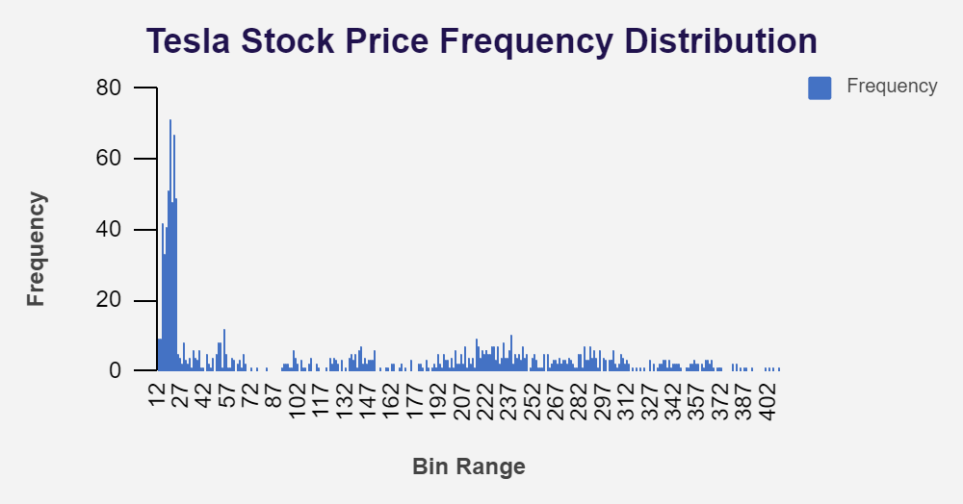
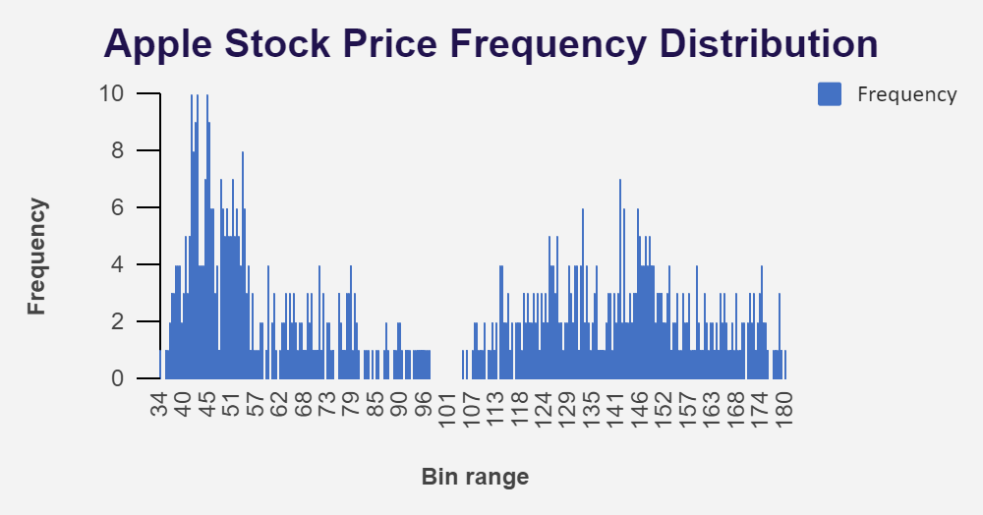
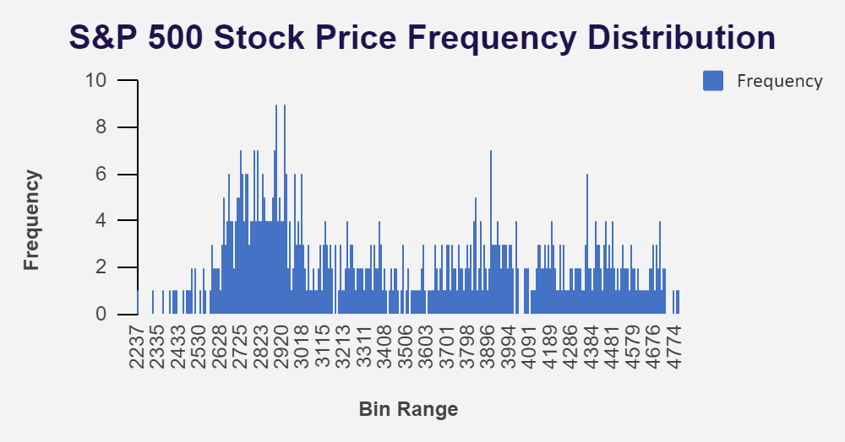
Stock Price Histogram Comparison

Slide 13
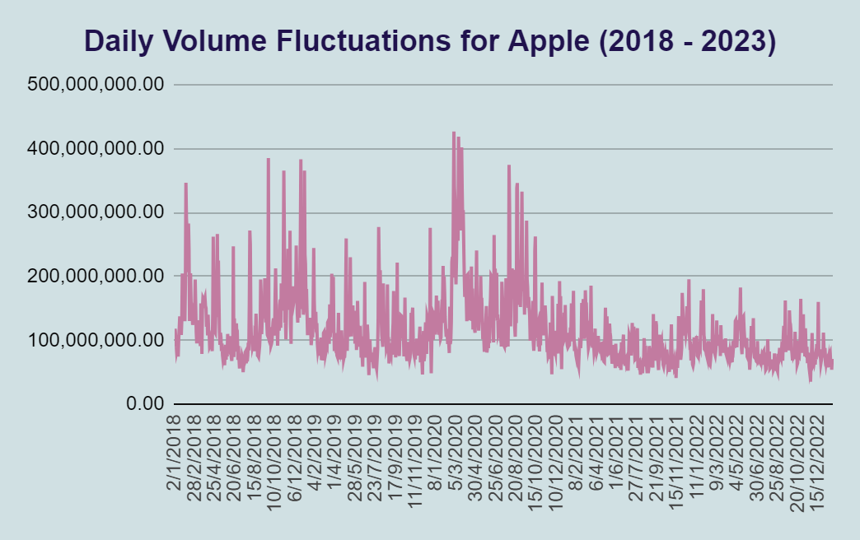
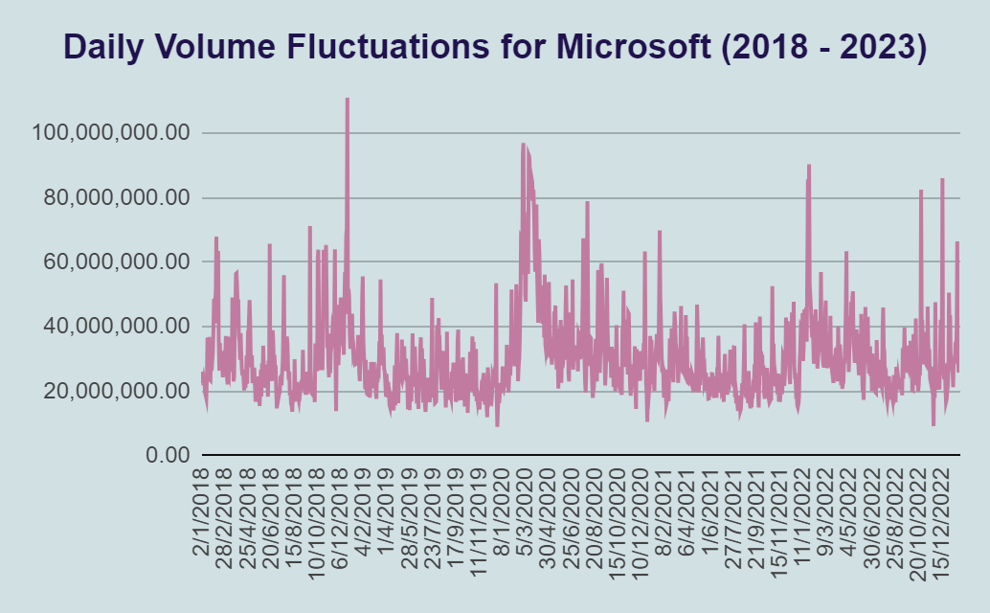
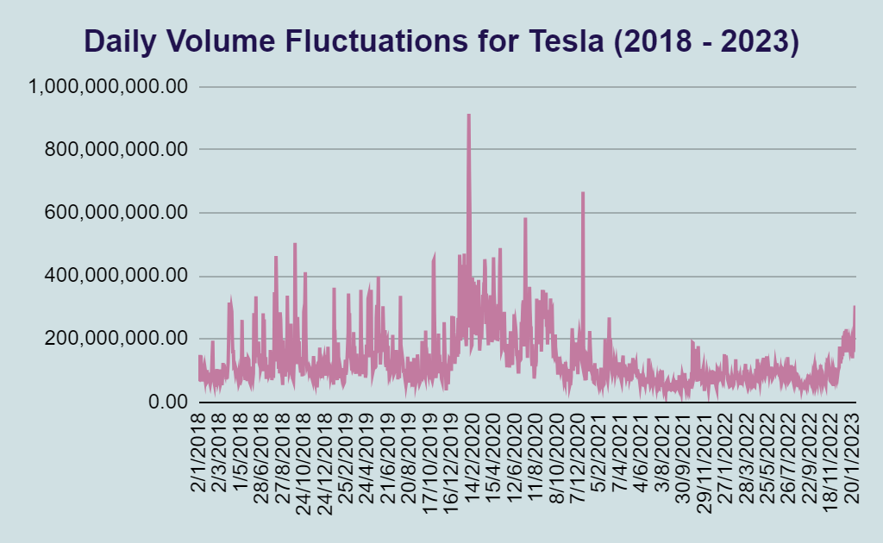
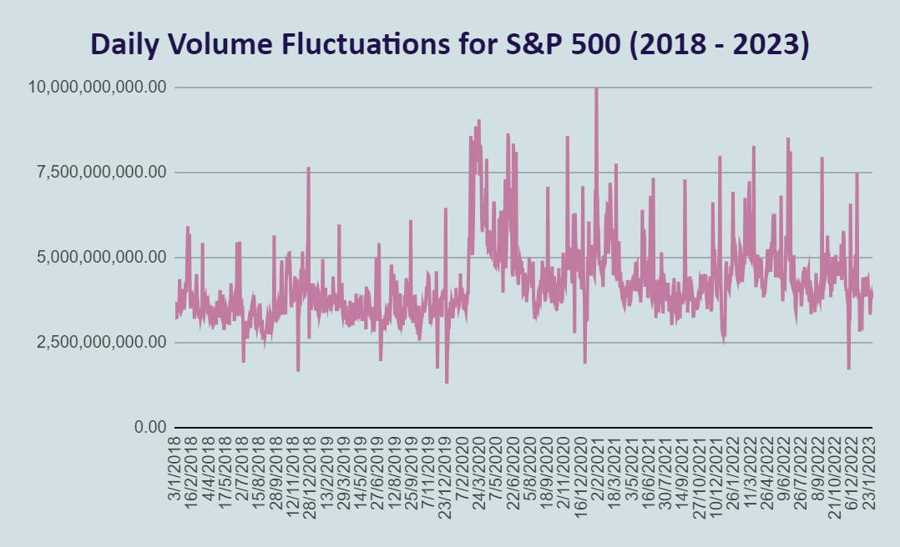
Daily Trading Volume Fluctuations

Slide 14
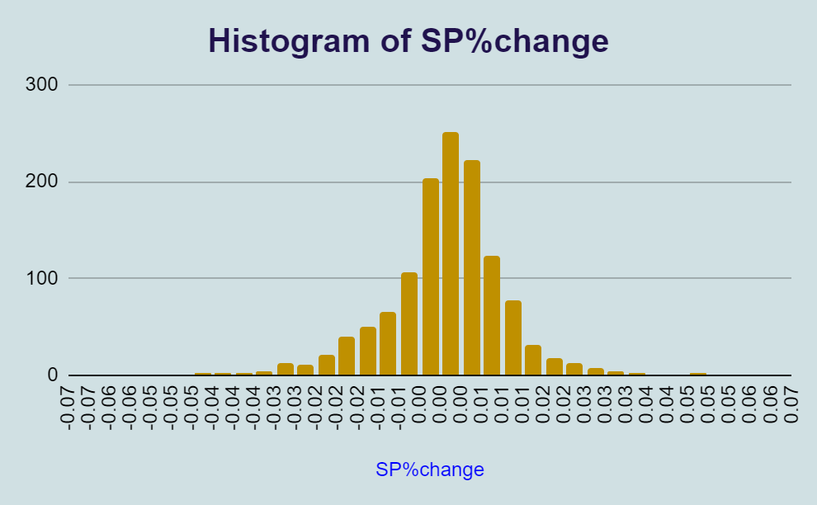
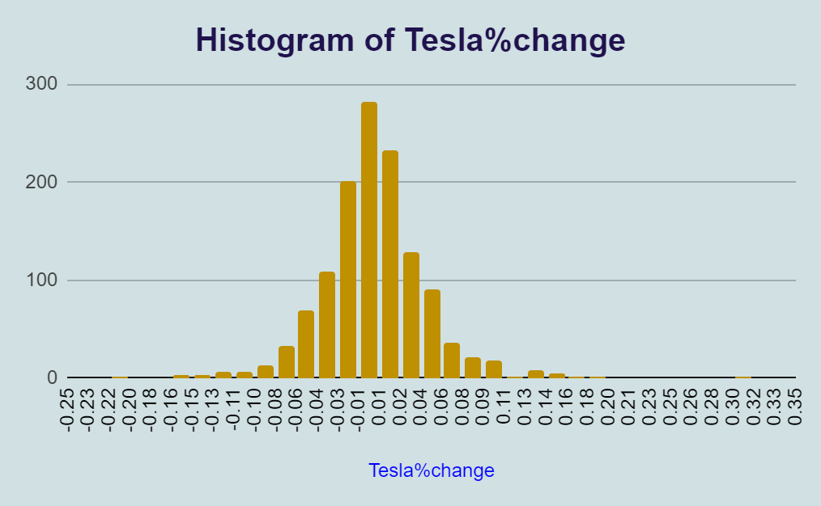
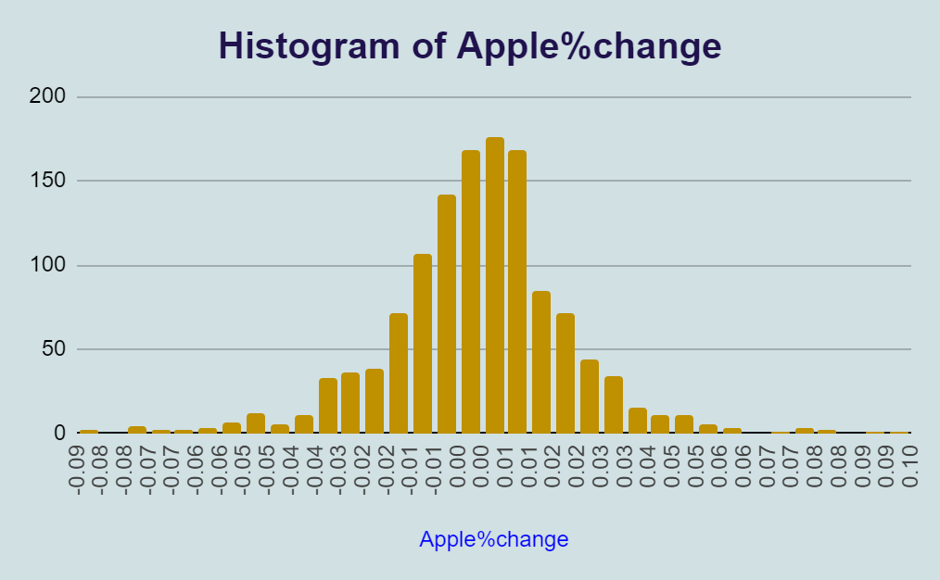
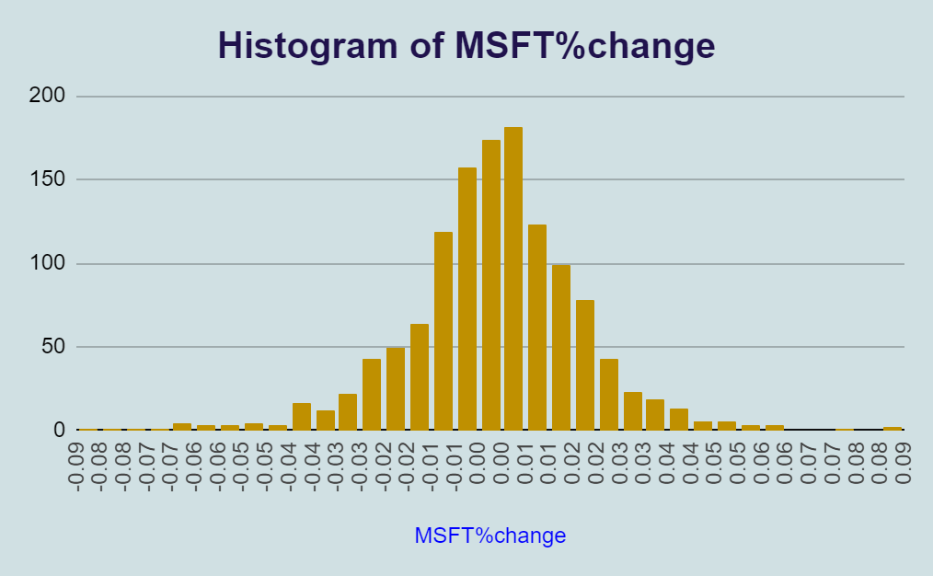
Stock
% Change Distribution Analysis

Slide 15
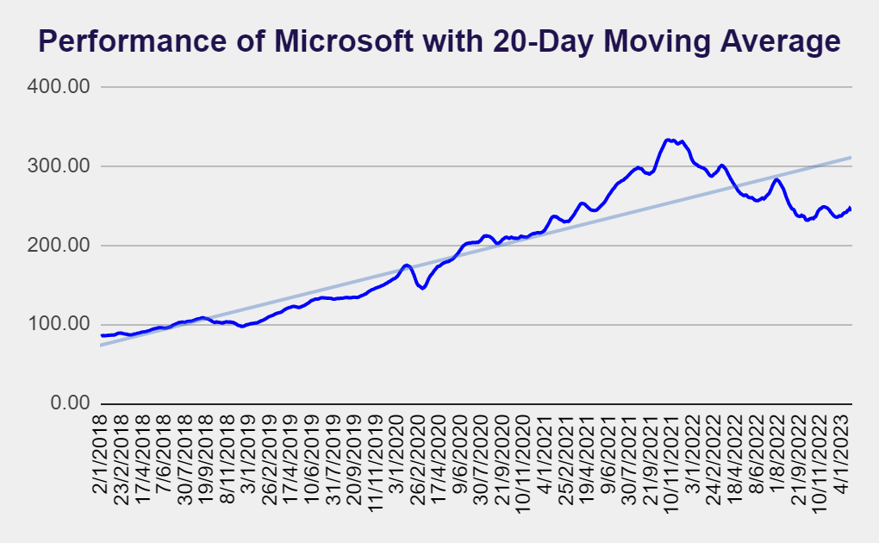
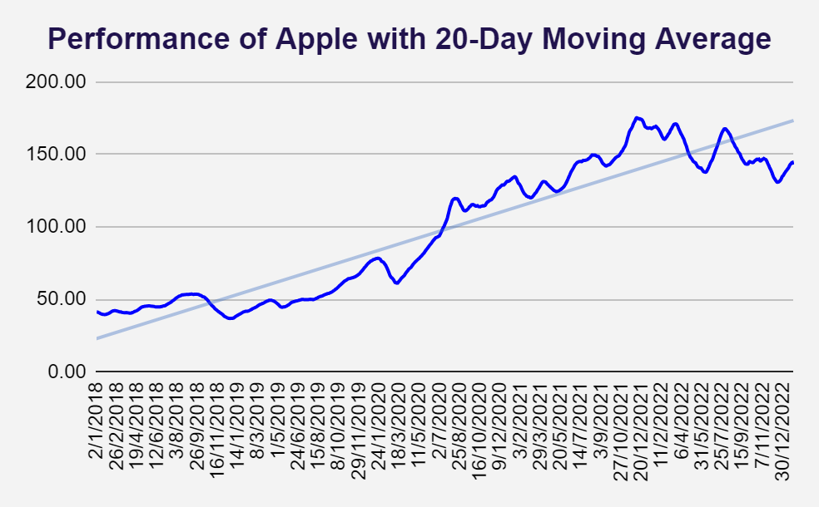
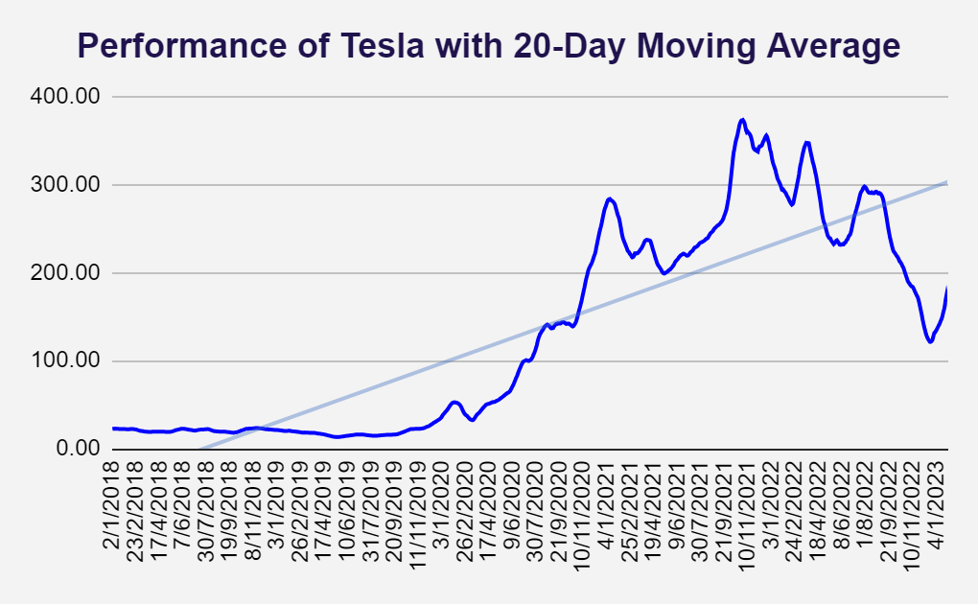
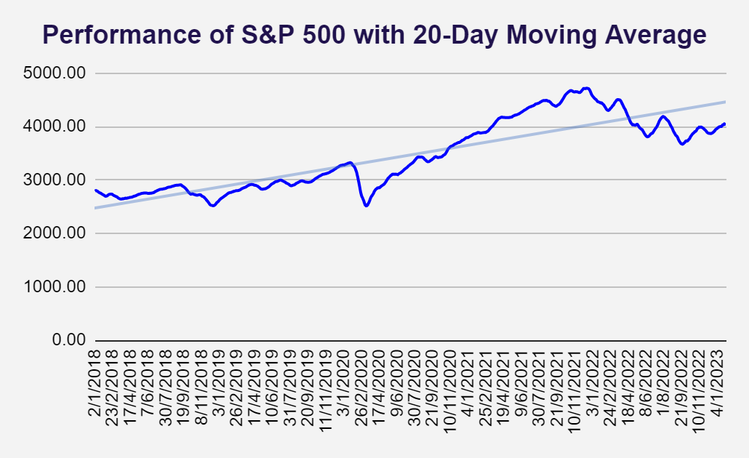
Tracking Stock Performance with 20-Day Moving Average
For each stock, the 20-Day Simple Moving Average (SMA) calculates the average price over the last 20 days, helping to smooth out short-term fluctuations and highlight the stock’s broader trend.

Slide 16
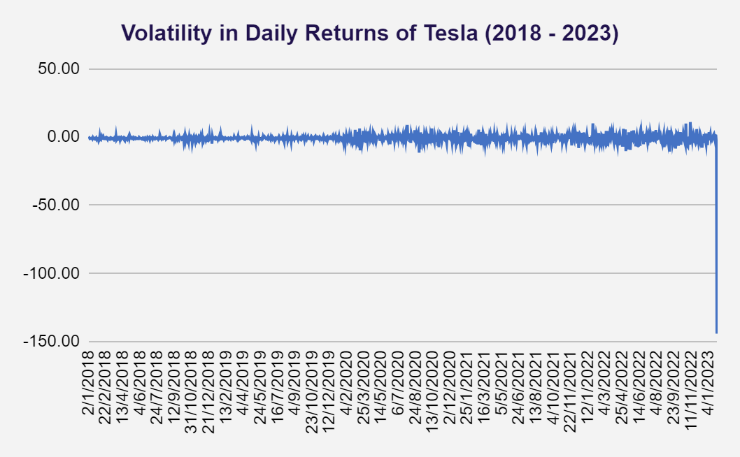
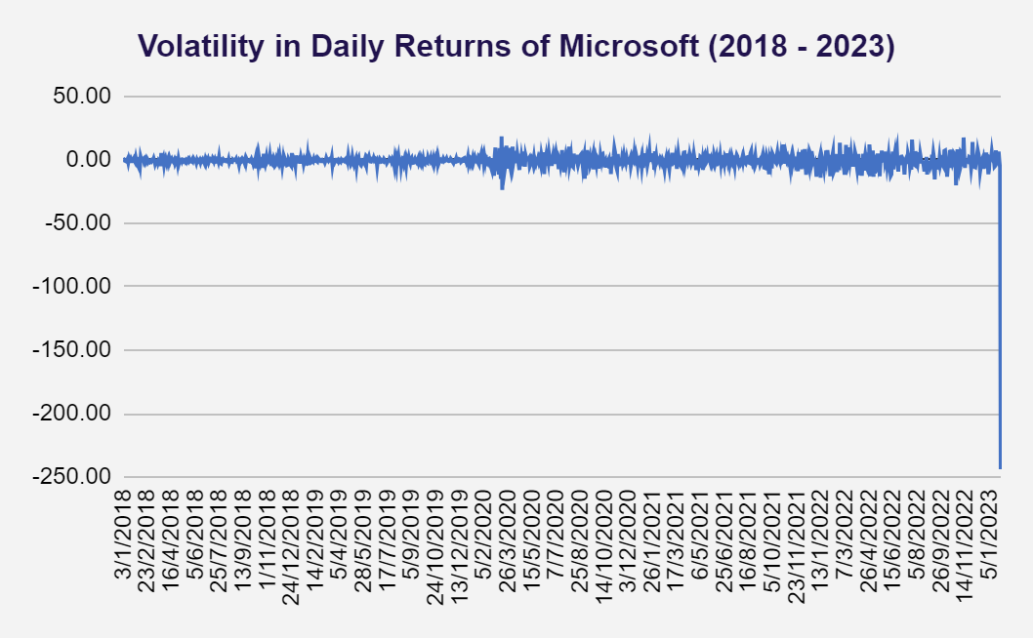
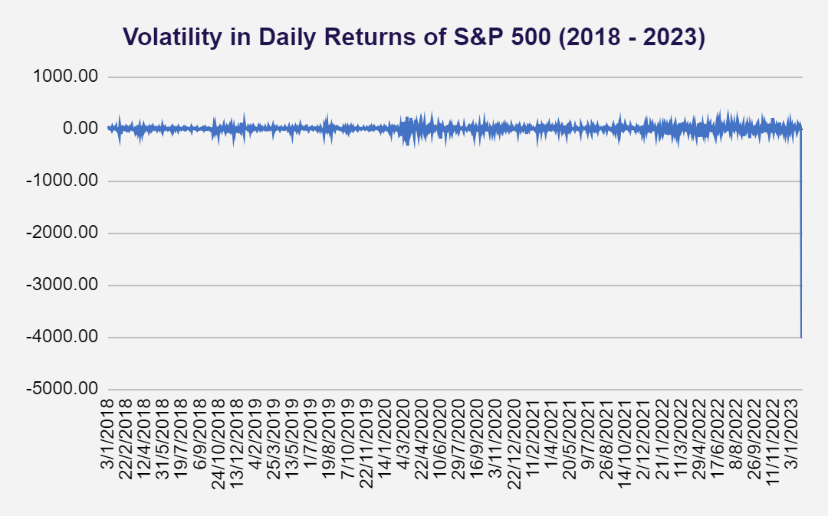
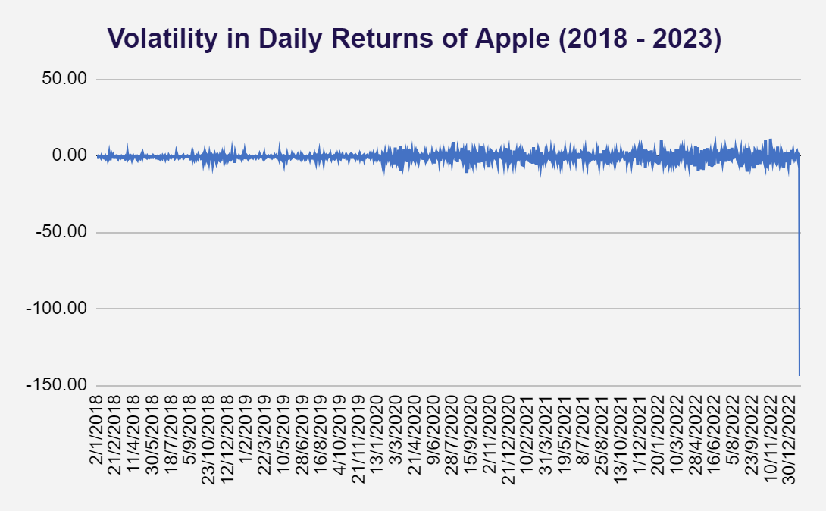
Evaluating Stock Volatility
The Volatility in Daily Returns trend chart (2018-2023) shows that Microsoft has stable returns with low volatility, while Tesla exhibits high volatility and significant fluctuations, indicating greater investment risk.
Apple displays moderate volatility, reflecting a balance of growth and stability. The S&P 500 (SPX) serves as a benchmark for overall market conditions, highlighting the varying risk profiles of these stocks over the past five years.

Slide 17
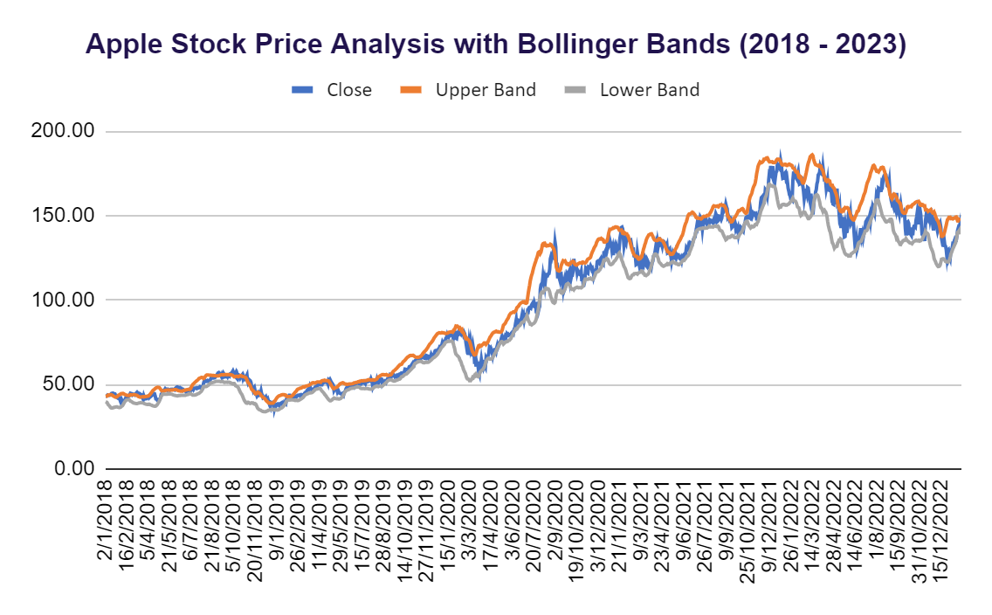
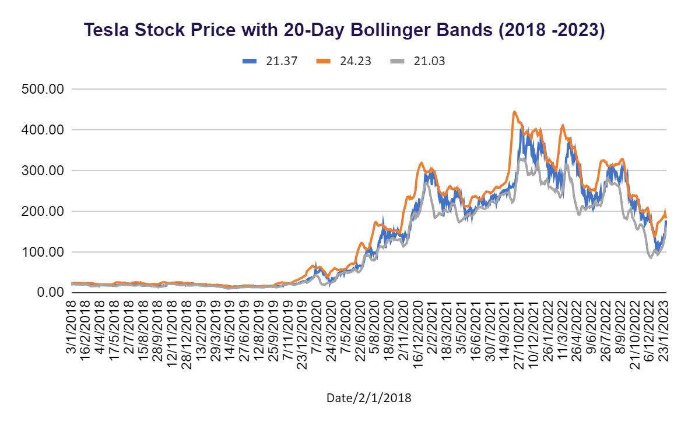
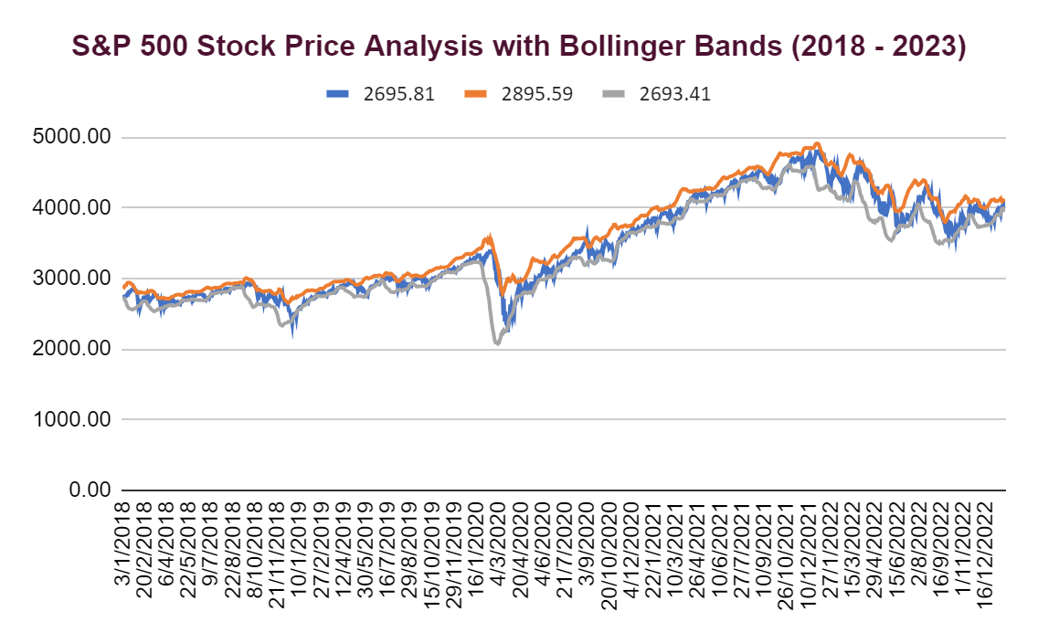
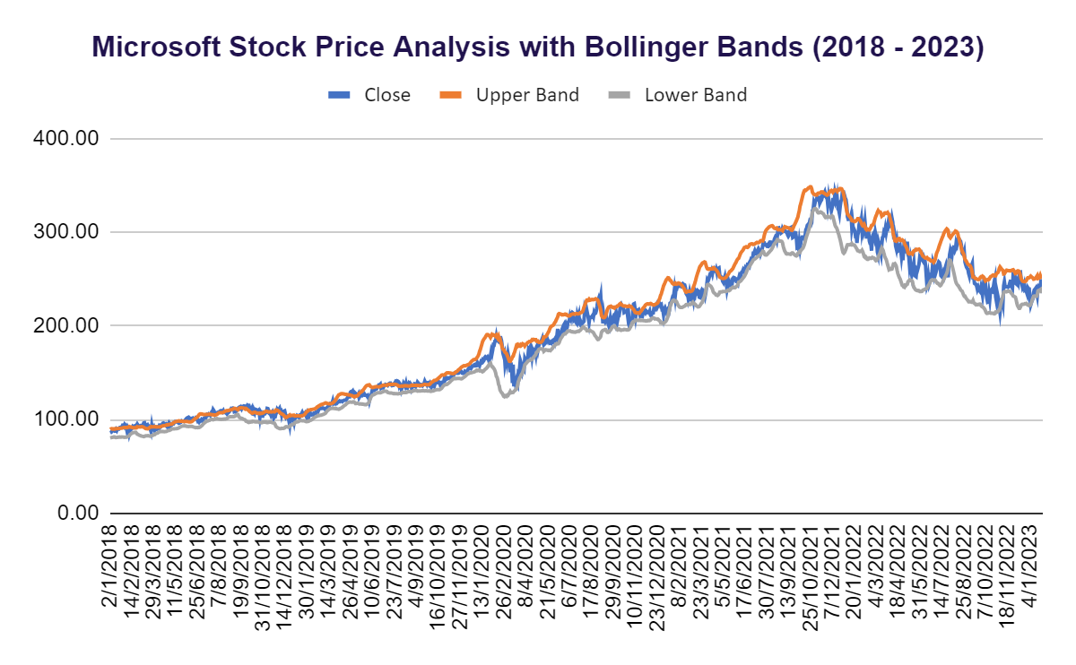
Bollinger Bands Insights
The stock price line will be flanked by the upper and lower Bollinger Bands, allowing you to see when the stock is overbought or oversold.

Slide 18
Beta measures a stock’s volatility relative to the market (S&P 500).
STOCK | BETA | RISK LEVAL | EXPECTED BEHAVIOUR
Microsoft | 1.22 | Slightly more volatile | Moves 22% more than the market in either direction.
Tesla | 1.45 | High volatility | Moves 45% more than the market, offering higher risk and return.
Apple | 1.23 | Slightly more volatile | Moves 23% more than the market, moderate risk and reward.
Beta = 1: Stock moves in line with the market.
Beta > 1: Stock is more volatile than the market (higher risk, higher reward).
Beta < 1: Stock is less volatile than the market (lower risk, lower reward)

Slide 19

CONCLUSION
The analysis of Beta values for Microsoft, Apple, and Tesla provides valuable insights into their volatility and risk profiles.
Microsoft, with a Beta of 1.22, and Apple, at 1.23, demonstrate moderate volatility compared to the market, indicating a balanced risk-return profile that may appeal to investors seeking stability with growth potential.
In contrast, Tesla's higher Beta of 1.45 signifies significantly greater volatility, making it an attractive option for aggressive investors willing to take on higher risk for potentially larger returns.
Overall, understanding these Beta values allows investors to align their investment strategies with their individual risk tolerance and financial goals.

Slide 20

RECOMMENDATIONS
To optimize investment strategies, investors should diversify their portfolios by including both moderate-risk stocks like Microsoft and apple, as well as higher-risk stocks like tesla to balance risk and return.
Continuous monitoring of beta values and market conditions is essential for making informed adjustments.
Additionally, analyzing other financial metrics, reassessing personal risk tolerance regularly, and staying updated on market trends will further enhance investment decision-making.

Slide 21
THANK YOU
Parita.hirpara1496@gmail.com

